Slide 1


Teamsters Local 237
Retiree Division
New Retiree Orientation
“Retired from Work
Not from the Union”

Slide 2
Are you REALLY retired?
Retirement is defined as being taken OFF PAYROLL and receiving a monthly pension from your pension system, NYCERS or BERS
The staff at the Retiree Division understands this is an important time for you. We are here to guide you and answer your questions.
Let’s begin by reviewing the steps of retirement …
Your pension, medical insurance and union benefits of Local 237.

Slide 3
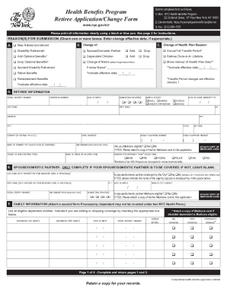

Did you apply for your
HEALTH INSURANCE?
Did you meet with your employer, obtain a retirement date and complete the Health Benefit Form?
Your employer sends the original Health Benefit Form to the Office of Labor Relations to enroll you in a medical insurance plan.
Your employer gives you a certified copy.
Hold on to your copy.
**This form is also available on the union website
www.Local237.org
Click on RETIREE DIVISION, then NEW RETIREE ORIENTATION, then FREQUENTLY USED FORMS

Slide 4
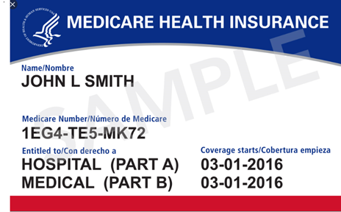
Are you 65+ years old or will be soon?
Let’s talk about Medicare..
Medicare is a medical insurance from the federal government.
It is managed through the Social Security Administration (SSA).
If any of the following applies, you must enroll in Medicare Part B:
You are 65+ years old, and not covered by your active job or working spouse.
You have been receiving Social Security Disability for 24 months
You have End Stage Renal Disease or Lou Garrets Disease
How to get Medicare Part B?
Receiving your social security checks already? The SSA sends you the
Medicare card about 3 months before your birthday month
If you’re NOT receiving Social Security, you will need to apply for Medicare Part B
three months before your 65th birthday.
If you’re receiving Social Security Disability, you will be eligible for Medicare Part B about 24 months from your first payment.

Slide 5
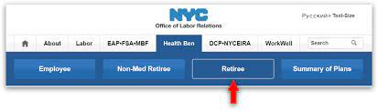
The Medicare Part B Premium Reimbursement
This benefit comes from The Office of Labor Relations
The Social Security Administration deducts a monthly premium from your social security check. Once you submit a copy of your Medicare card to the Office of Labor Relations, you will be enrolled in the Medicare Reimbursement Program. You will receive an annual reimbursement for the premiums paid in the previous year.
For information about Medicare Part B Reimbursement- visit the Office of Labor Relations Health Benefit Program’s website
https://www1.nyc.gov/site/olr/index.page

Slide 6



Did you apply for your PENSION?
Did you complete and submit a SERVICE RETIREMENT APPLICATION with your pension system?
If you apply in person, you receive a copy of it with a date stamped. Hold on to it.
If you applied online, print out your proof of submission.
  New York City Employees’ Retirement System (NYCERS) contact at 347-643-3000 or visit www.NYCERS.org
Board of Education Retirement System (BERS)
contact BERS at 929-305-3800 or visit www.bers.nyc.gov

Slide 7

Have you enrolled as a RETIREE OF LOCAL 237?
To obtain your union benefits YOU MUST ENROLL as a RETIREE:
Contact Local 237 Welfare Fund at 212-924-7220 to request a
RETIREE ENROLLMENT PACKAGE.
It will include instructions and a list of documents to submit, the list includes the following:
**RETIREE ENROLLMENT FORM
**A COPY OF YOUR HEALTH BENEFIT APPLICATION,
THE NYCERS OR BERS CONFIRMATION and a COPY of your 1st PENSION CHECK when you receive it. You don’t have to wait for your pension check to enroll. The Welfare Fund is located on the 3rd floor of the union building.
**This form is also available on the union website
www.Local237.org
Click on RETIREE DIVISION, then NEW RETIREE ORIENTATION, then FREQUENTLY USED FORMS

Slide 8

YOUR LOCAL 237 WELFARE BENEFITS:
AND ELIGIBLE FAMILY MEMBERS.
DENTAL: ANNUAL CAP/YEAR OF $1250 FOR EACH MEMBER
EYEGLASSES AND EXAM: ONCE/2 YEARS FOR EACH MEMBER
AND ELIGIBLE FAMILY MEMBERS.
HEARING AID: $1000 ONCE IN 5 YEARS
DEATH BENEFIT: $2500 MEMBER ONLY.
PRESCRIPTION DRUGS; CAP DEPENDS ON AGE AND/OR DISABILITY AND YOUR HEALTH INSURANCE PLAN.

Slide 9
Local 237 Retirees Legal Services Plan
Free legal representation in specific legal matters
• Absolutely no attorney fees
• After paying a $150 deductible, $500 available for your litigation
Expenses For RETIREES only, there is a reimbursement schedule for paid
attorney fees incurred when you live outside of our covered area
Issues covered by Legal Services includes the following:
Family Law: custody, orders of protections, and some child support matters
• Matrimonial Actions
• Housing Court Tenant representation
• Foreclosure Actions
• Chapter 7 and Chapter 13 Bankruptcy Filings
• Real Estate: purchase, sale and refinance
• Wills, Powers of Attorney, and Health Care Proxies

Slide 10
Welcome to the Retiree Division!
“Retired from Work, Not from the Union”
The Retiree Division staff congratulates
you on your retirement!
We are located on the 6th floor of the union headquarters, and have friendly, knowledgeable staff to answer questions, provide social work services, share community resources, coordinate educational seminars, recreational activities and so much more!

Slide 11
THE RETIREE DIVISION STAFF
Julie Kobi Director
Edith Johnston Deputy Director
Elaine Williams -Francis Assistant Director
Luz Nieves-Carty Assistant to the Director
Shavon Banks Secretary
Noelia Quinones Assistant Secretary
The Retiree Division is located on the 6th floor
216 West 14th Street, New York, NY 10011
Telephone: 212-807-0555
Email: retirees2@local237.org
“Retired from Work, Not from the Union”

Slide 12


